Slide 1
sales insights for AtliQ hardware
File created on: 12/6/2021 12:53:26 PM

Slide 2


Slide 3


Slide 4
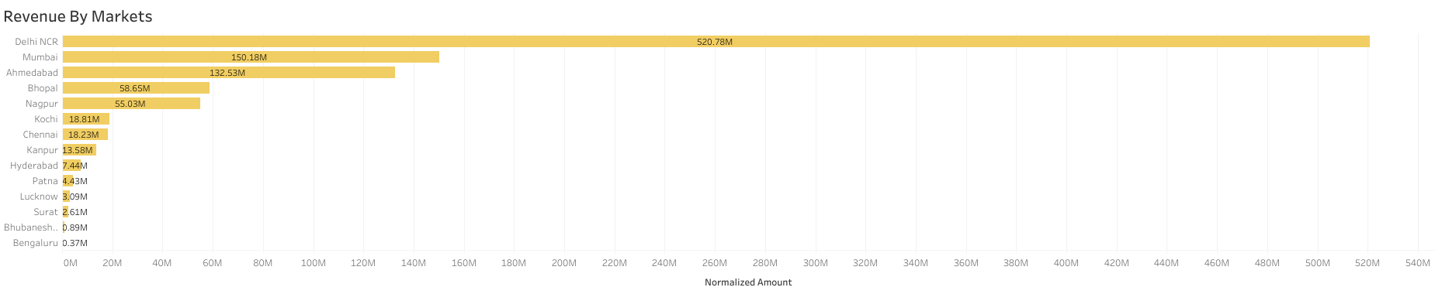

Slide 5
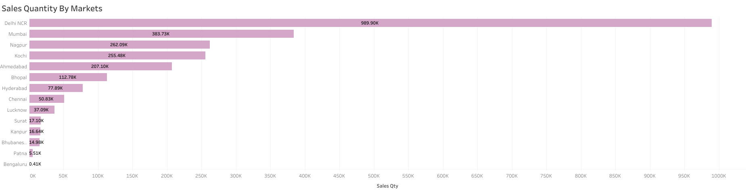

Slide 6
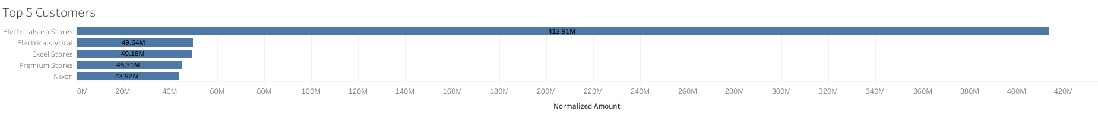

Slide 7
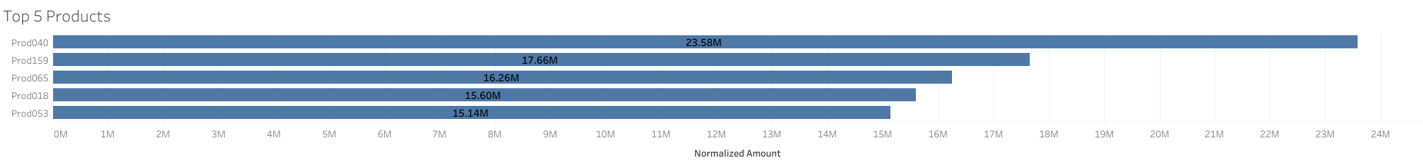

Slide 8
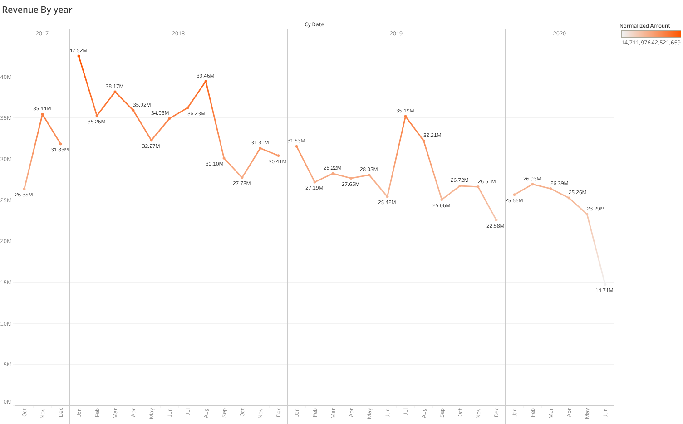

Slide 9


